Slide 1
2025 NLS Midlands - Southern
KLAS Users’ Group Meeting
Katy Patrick, Technical Writer
Katharina Stevens, Customer Support

Slide 2
Agenda
Keystone Staff
Keystone Customers
Keystone Services Updates
KLAS Development Updates
KLAS Users’ Resources

Slide 3
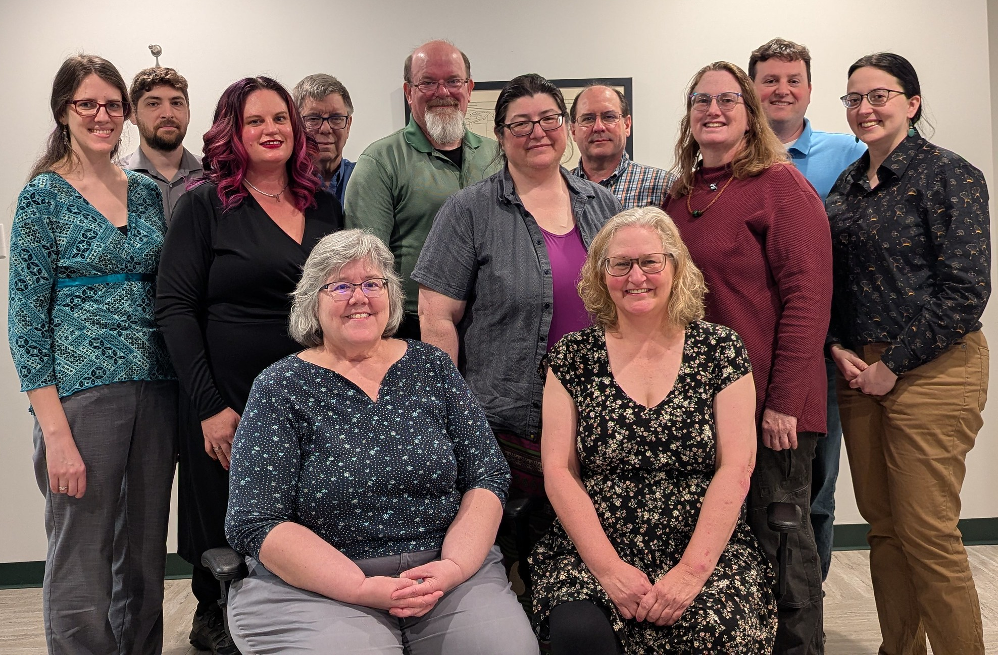
Keystone Staff
Customer Support
Development
Systems Admin / IT
Sales
& Administration

Slide 4
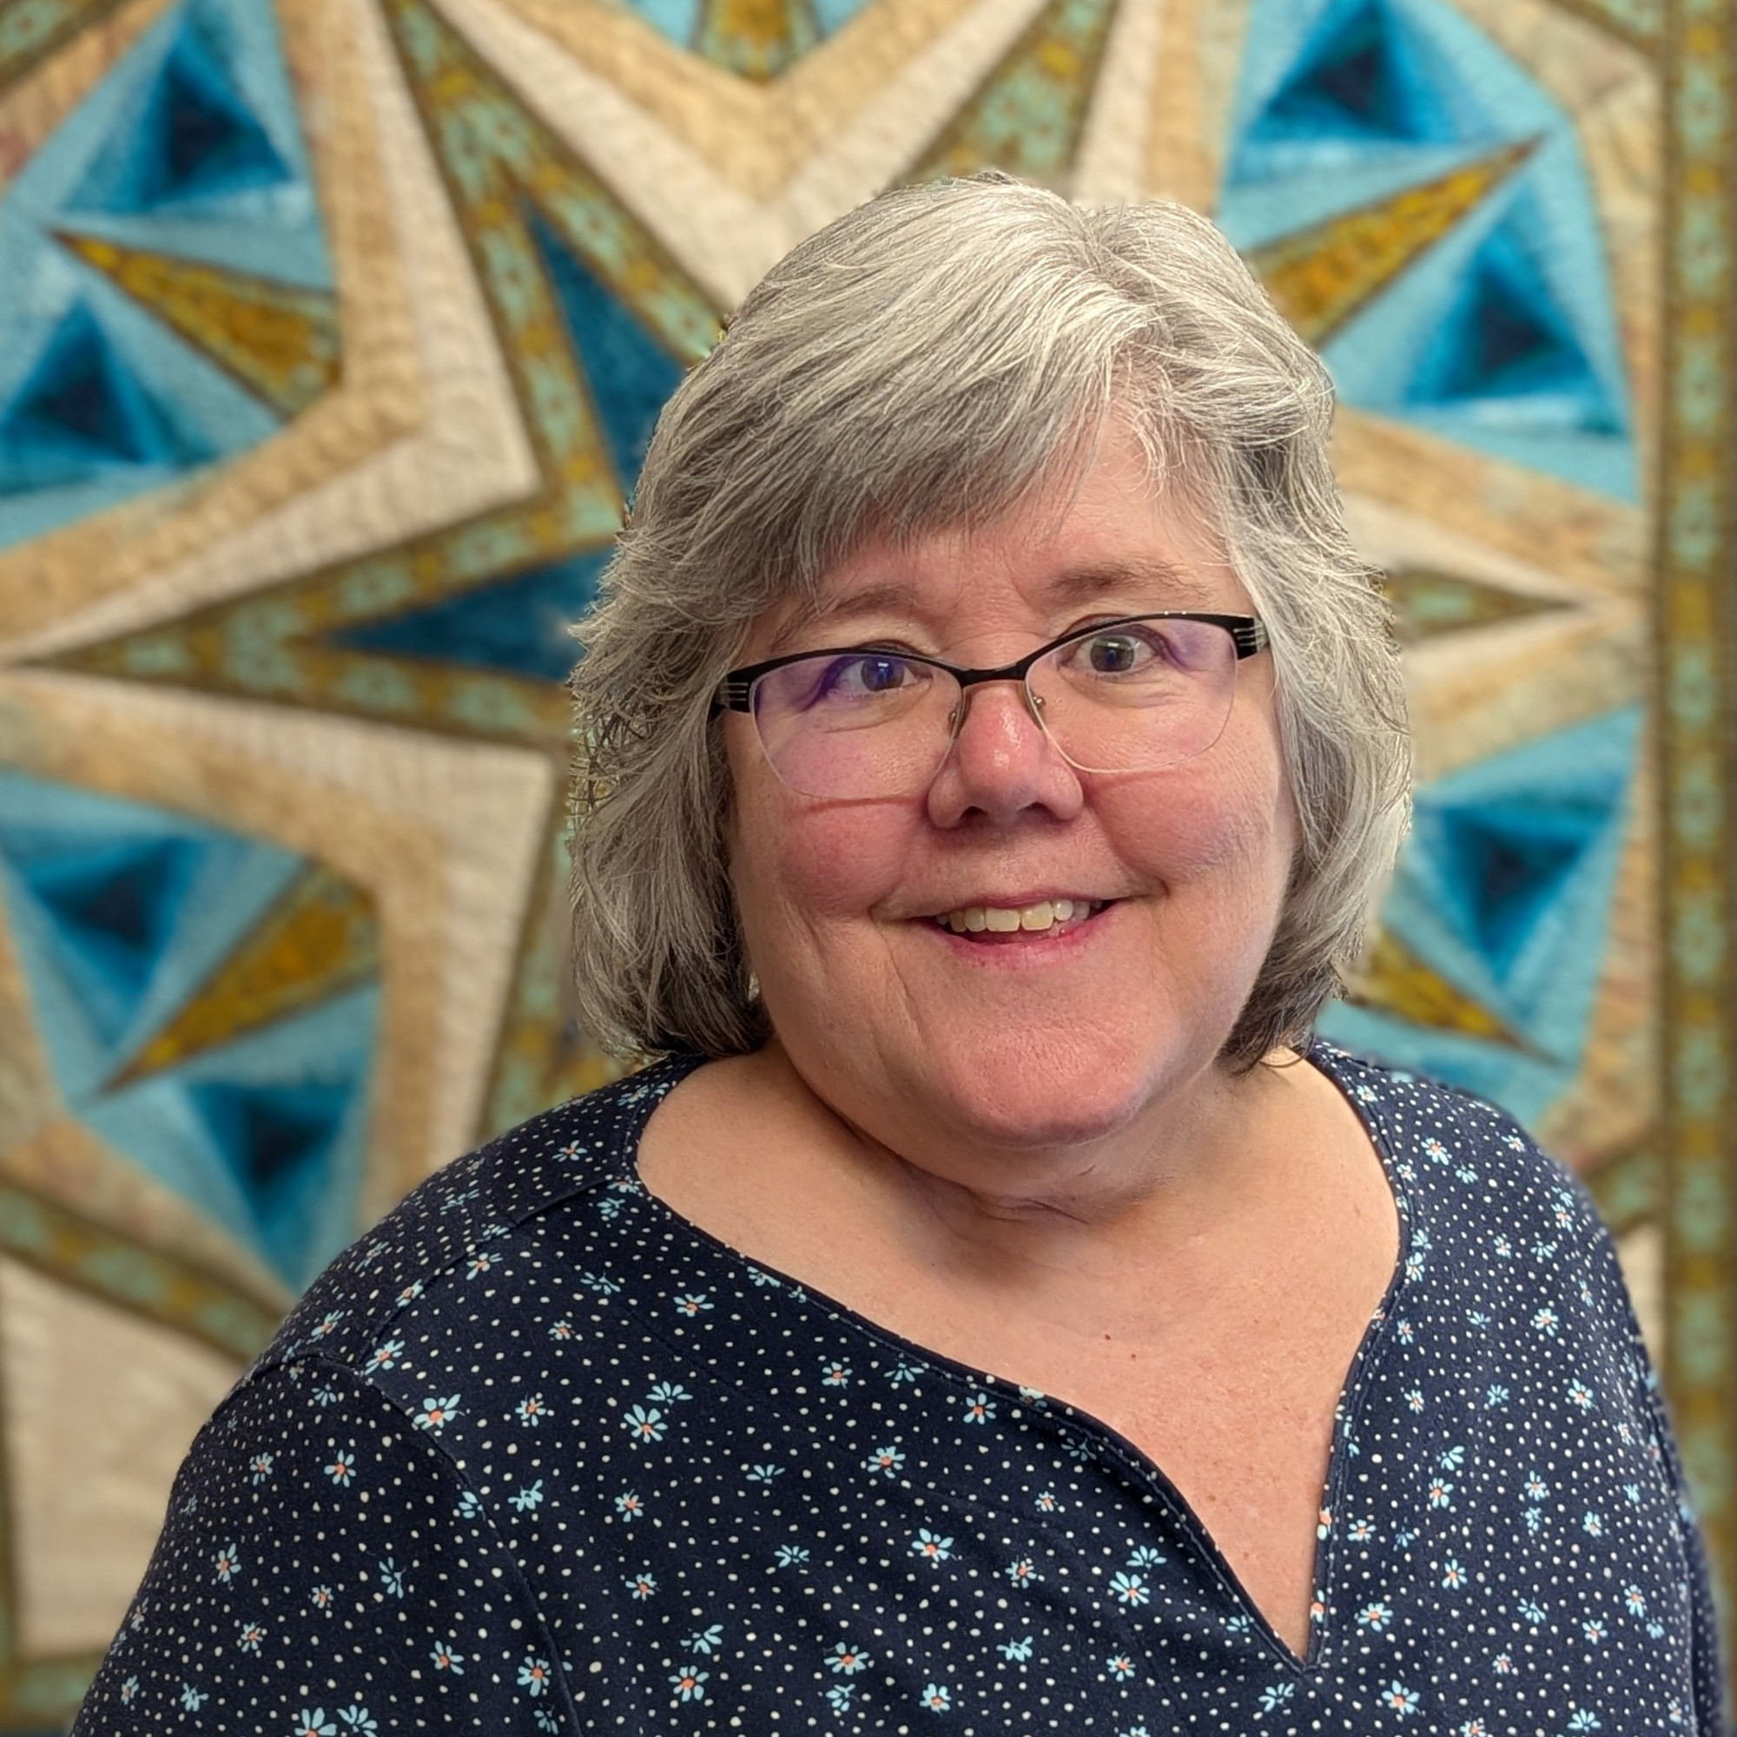
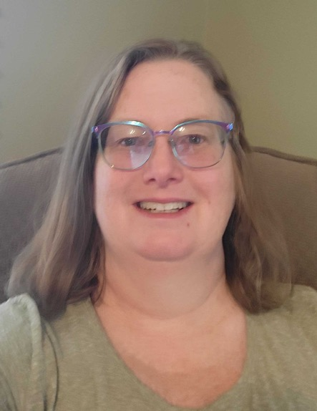
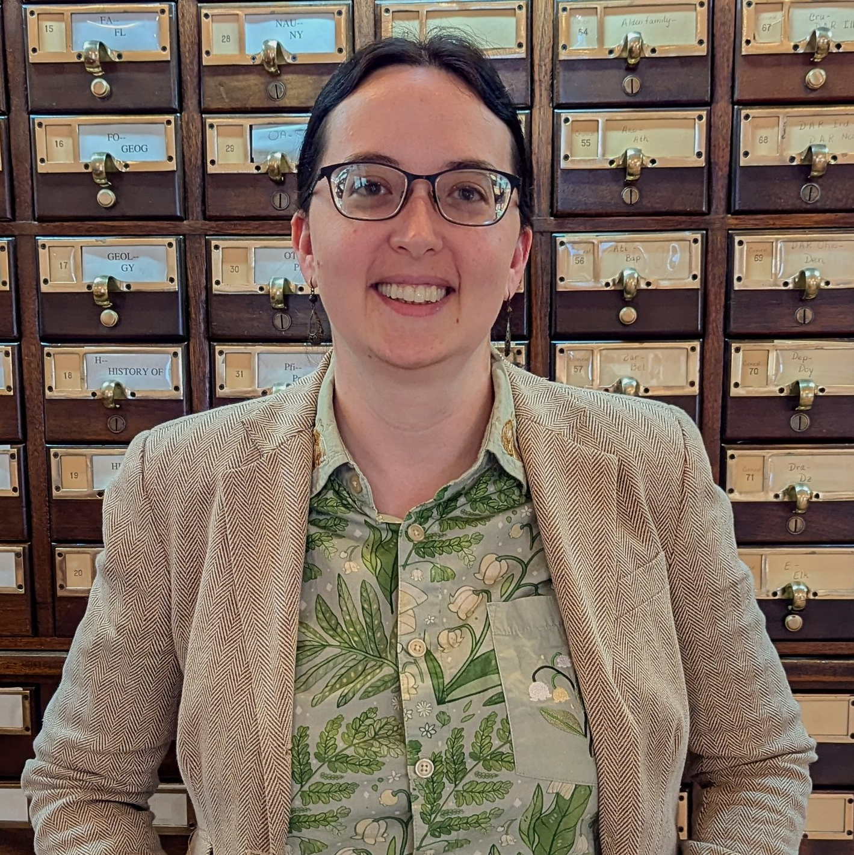
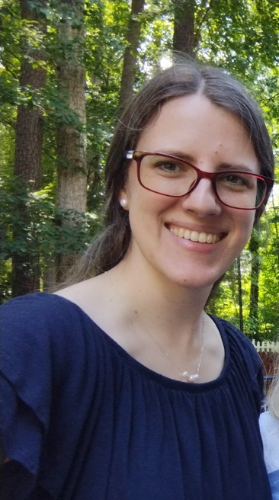
Customer Support
Nancy Honeycutt,
Manager,
Customer Support
Katy Patrick,
Technical Writer
Marion Campbell,
Customer Support Specialist
Katharina Stevens,
Customer Support Specialist

Slide 5


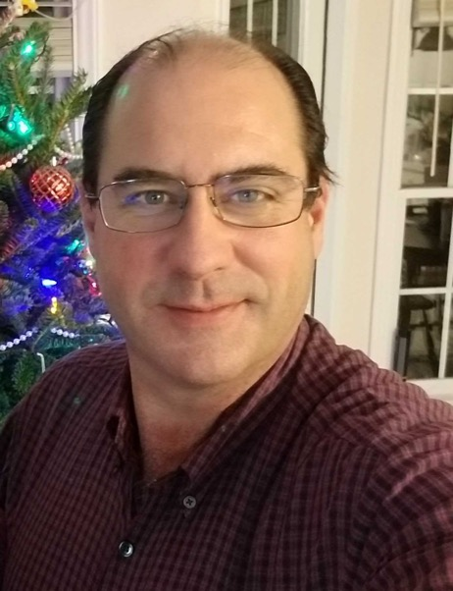

Development
George Martell,
Software Development
Specialist
Mitake Burts,
Chief Product
Development Officer
Kyle Honeycutt,
Manager,
Software Development
John Carpenter,
Software Development
Specialist

Slide 6


Systems Administration / IT
Mark Gardner, Manger,
Systems & Networking
Lee Higley, Lead Consultant,
Information Technology

Slide 7
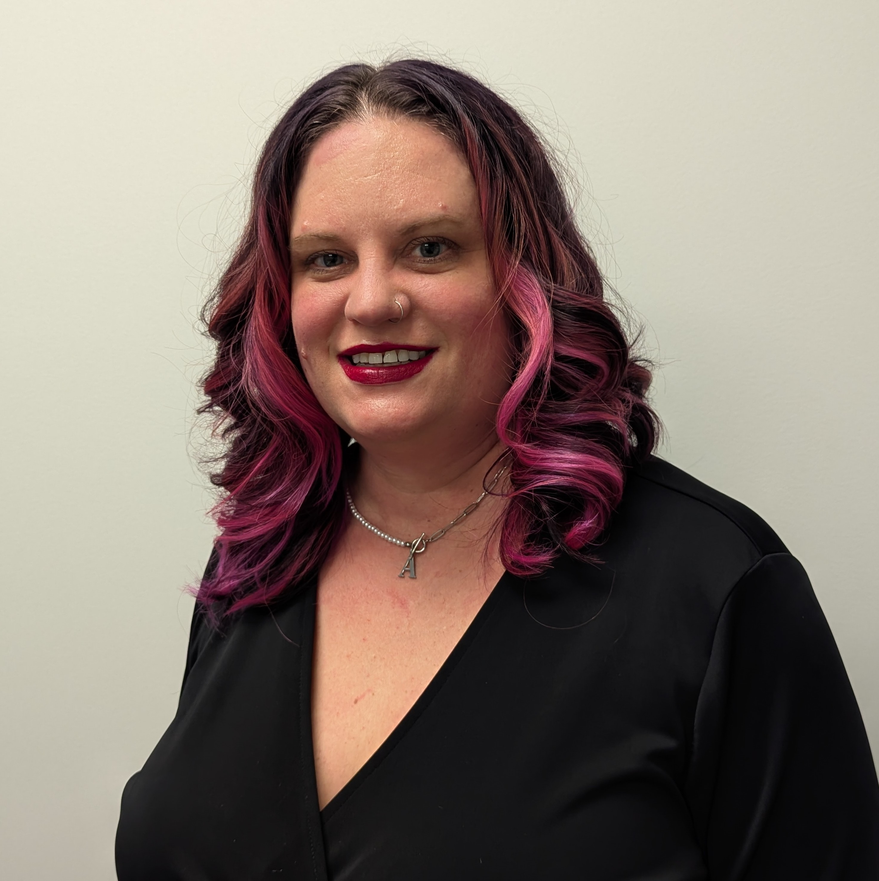
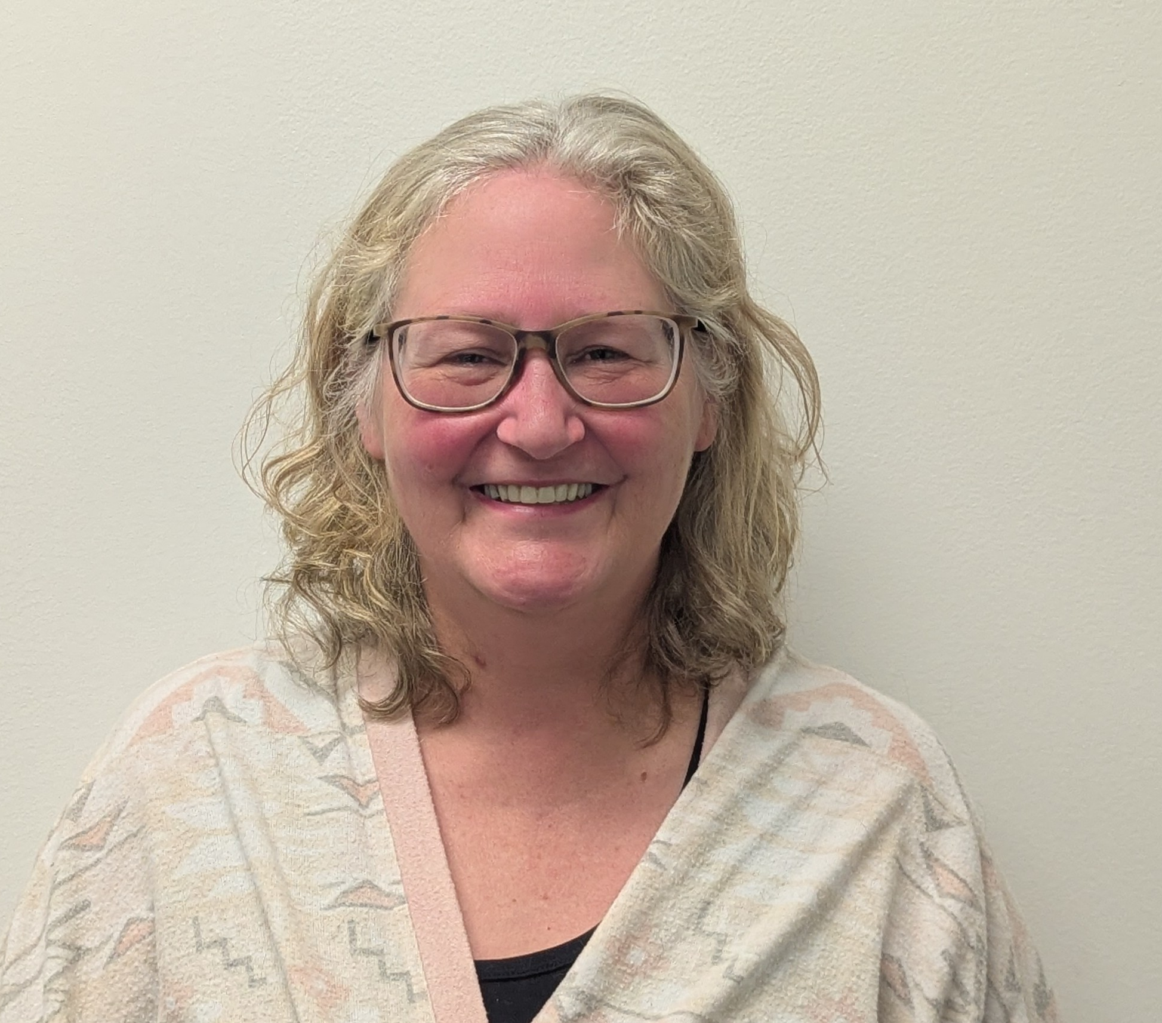

Sales / Administration
Tracey Fye, Office Manager
Drea Callicutt, Director of Marketing, Sales, & Communications
James Burts, CEO

Slide 8
Keystone Customers
New KLAS Users
Current Library for the Blind & Print Disabled Users
Current Instructional Resource / Materials Center Users

Slide 9
New KLAS Users
Now Live!
  Minnesota State Services for the Blind (SSB), Minnesota Department of Employment & Economic Development
  Michigan Braille and Talking Book Library
Implementation NOW Underway:
  Kentucky Instructional Resource Center

Slide 10
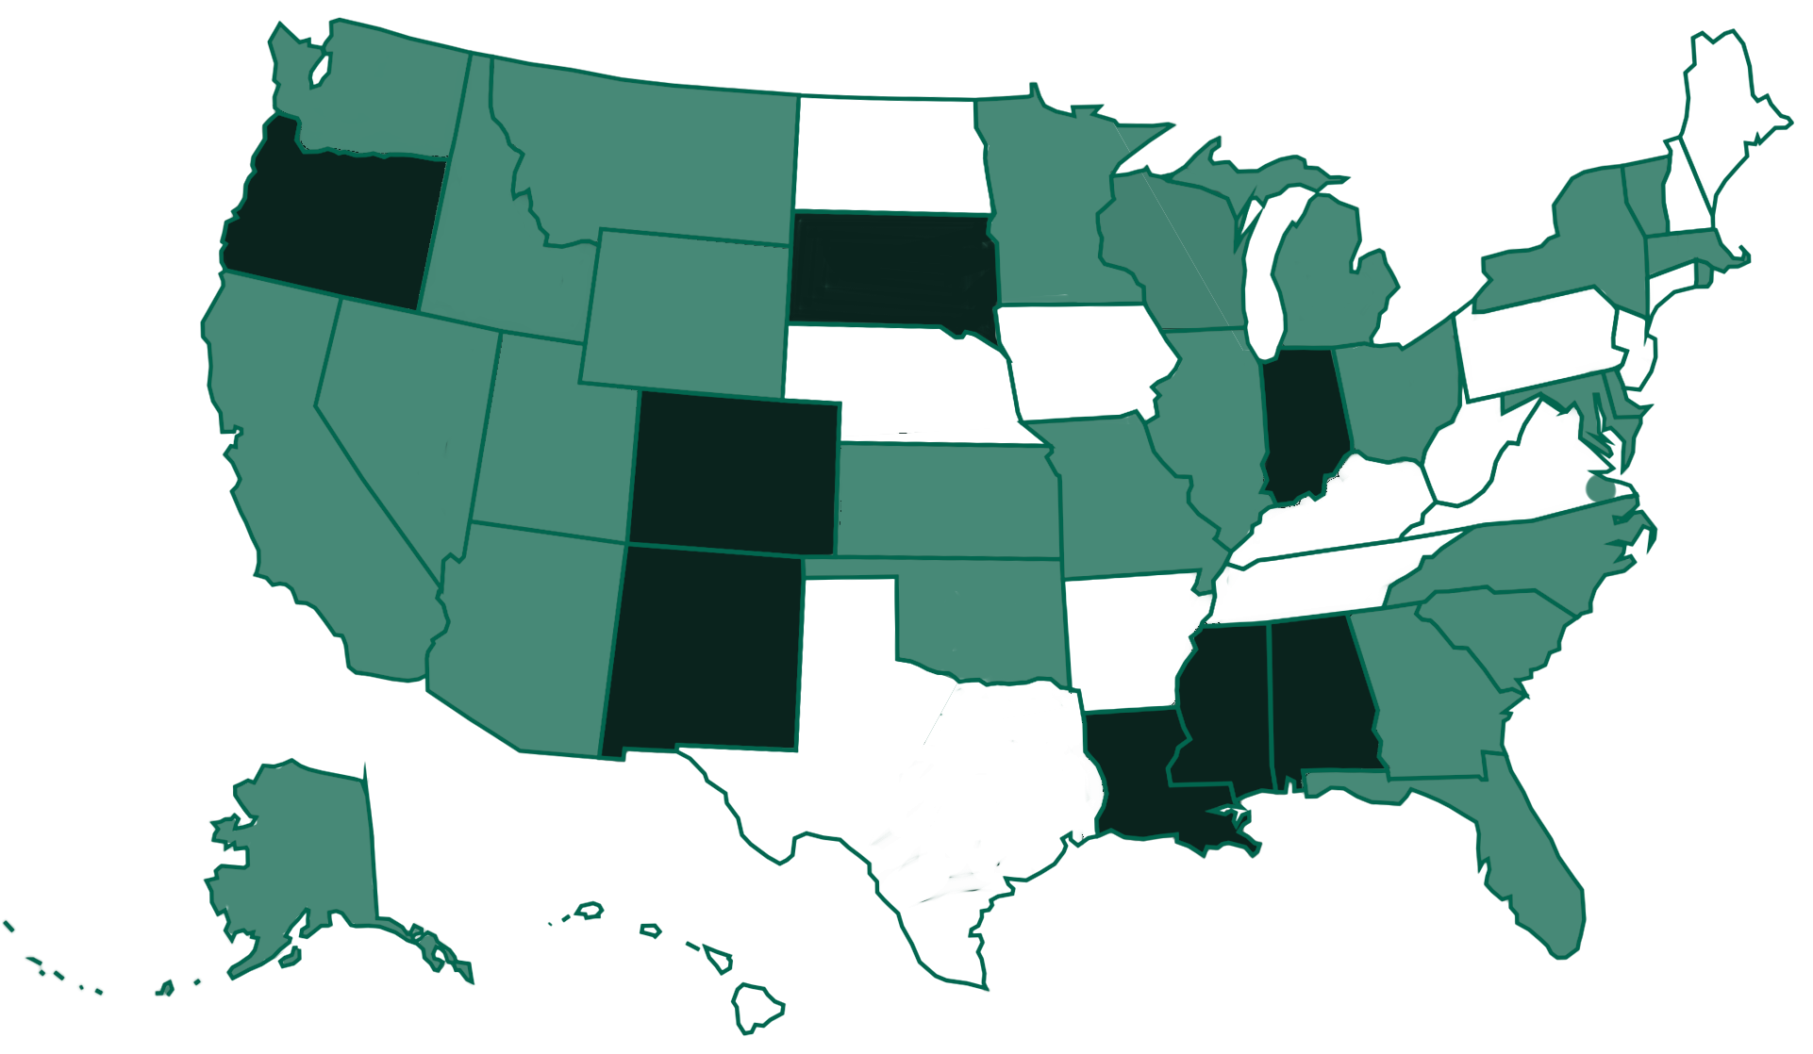
Current KLAS LBPD Installations

Slide 11
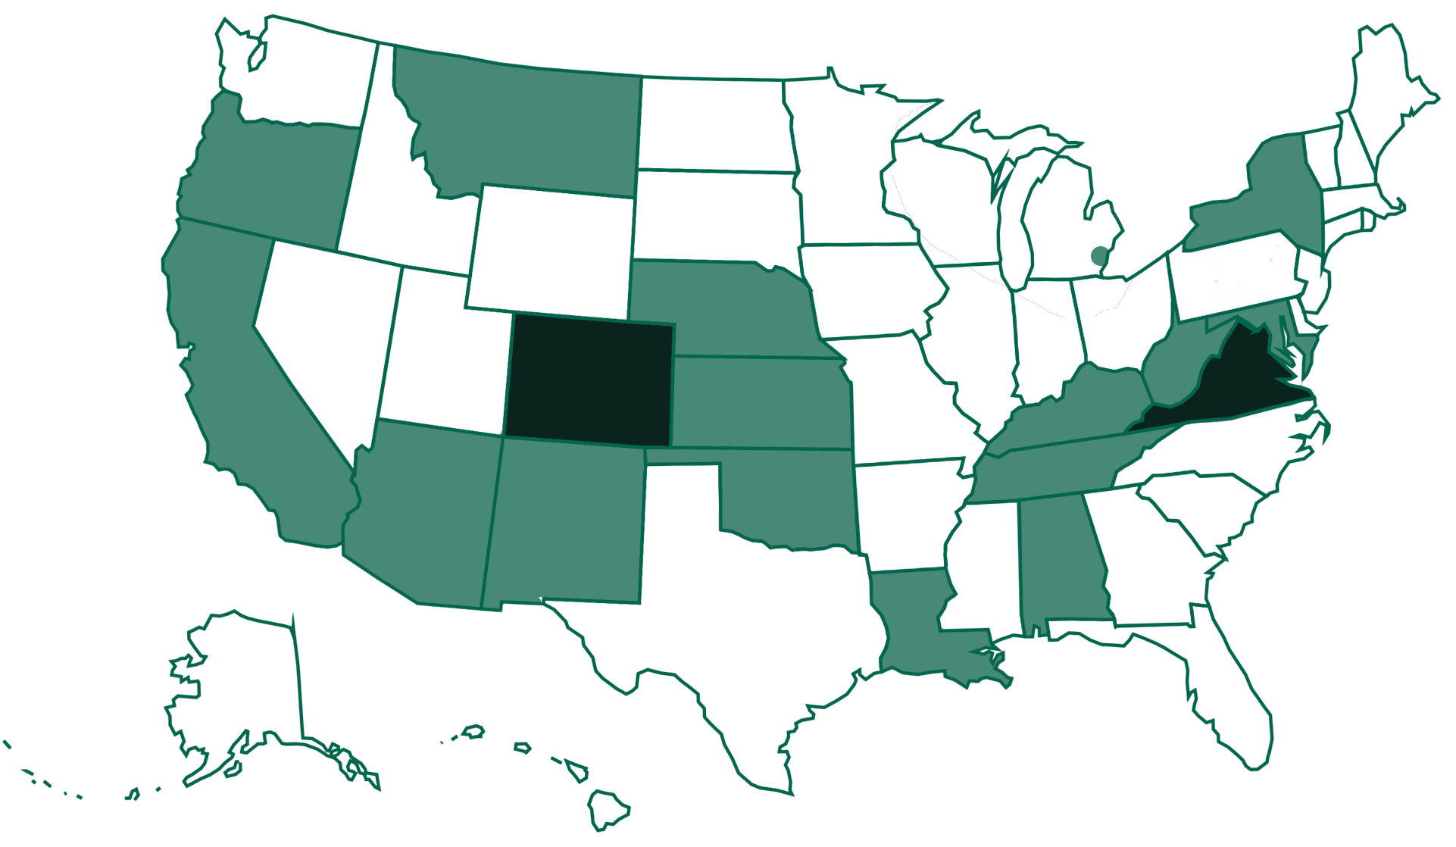
Current KLAS IRC / IMC Installations

Slide 12

Keystone Services Updates
Hosting:
  2024 SSAE Certification
  Completed
Keystone Cataloging Service:
  Basic, Series & “All-in” Options
  12,306 Series Tracked as of 9/1/2025
    30-60 added & 400-600 tags checked monthly
  1,500-2000 Title records loaded monthly
Notes:
Mitake is presenting on the Cataloging service end of the Tues 2:30pm LBPD track

Slide 13
KLAS Users’ Resources:
KLASUsers.com
  Email ks7@klas.com to request an account
  Forums, Release Lists, MARC Records, Training Recordings, How-Tos, User Manuals, etc.
KLAS Users’ & IRC User listserv
  Email ks7@klas.com to be subscribed
KLAS Users’ Conference & MiniConference
  May 2026 – free, online MiniConference
  2027 – Hybrid Users’ Conference in Worcester, MA

Slide 14
KLAS Users’ Resources:
Ongoing webinars & roundtables
  Monthly during MiniConference year
  Quarterly during Hybrid Conference year
Keystone’s Social Media
  Facebook & LinkedIn
Administrator Training
  2026 dates TBD
KLAS Users’ Group Meetings at NLS & APH

Slide 15
KLAS Users’ Group
New Officers as of 8/1/2025
  Josh Easter, President, South Dakota Braille & Talking Book Library
  James Gleason, Vice President, Perkins Library
  Maureen Dorosinski, Immediate Past President, Florida Braille & Talking Book Libraries
  AnnaMarie Theiss, Secretary, Alabama Instructional Resource Center
Committees
  KLAS Development Advisory Committee (KDAC)
  Logistics Committee
  Program Committee

Slide 16
KLAS Development Updates
Automatic Service Queues
Catalog performance improvement
  Resulting bug fixes
Manual Seed Serial correction
Reminders:
  NLS Acknowledgements - automated blocks available
  PIMMS Deleted status can now be reactivated
  Institutions should have a First & Last Name on the email for BARD
Notes:
Auto-add Service Queue – When a Medium Profile is added, the respective Service Queue is added too. Set per Medium and per Library (ex, can be set for DB and DS, without creating queues for Large Type, Braille, and Electronic). 7.8.27, so all should have this.
Catalog – Query performance improvement in 7.8.27, bug fixes in 7.8.28
Seed Serial – HasNow check was not considering the Service Queue or Pending Dup Orders. For local serials, if not all created orders were duplicated the day they were created, this could result in duplicate issues going out. Fixed in 7.8.28
Acknowledgements: For juveniles, ParentalAck preference for the Answer and Answer Date, AltContact type must be Parent or Guardian. For schools, LegalAck preference and AltContact type Legal. AltContact must have a first and last name. One block for AltContact, one for preference. Can get a report of all records with the block.

Slide 17
KLAS Development (7.8.29)
Improved Issue Name display
  Items Tab – longer character limit
  (note: data viewer field available)
  Service Queue – data issue caused some serials not to display issue name; now cleaned up
  Duplication Orders – Issue now displayed after serial name as on Service Queue
Create Dup Order from Queue performance improvement

Slide 18
KLAS Development (7.8.30)
WebOPAC Security update
Auto-add Service Queue no longer overrides custom values with the default
“Button” button caught and labeled on the Patron Requests tab
Equipment transfer improvements
  Better error message if it fails
  Better handling of deleted Equipment

Slide 19
KLAS Development (7.8.31)
WebOPAC Screen Reader navigation improvements
  “Skip to main content” link
  ARIA landmark roles
  ARIA labels on Quick Request screen
  AIRA labels & roles on search results
  Redundant title attribute/alt text on Exclude facets fixed
  Browse Group heading level fix
Improved labels on Quick Request buttons

Slide 20
KLAS Development (Upcoming)
Keycloak Integration (SSO)
Security improvements
  Additional improvements in WebOPAC
  In the KLAS application
NLS Patron Activity report
USPS intelligent mail API
  Improvements for Gutenberg customers
  Access for Scribe customers
Push to BARD Wishlist

Slide 21
And introducing…
…(insert drumroll here)

Slide 22
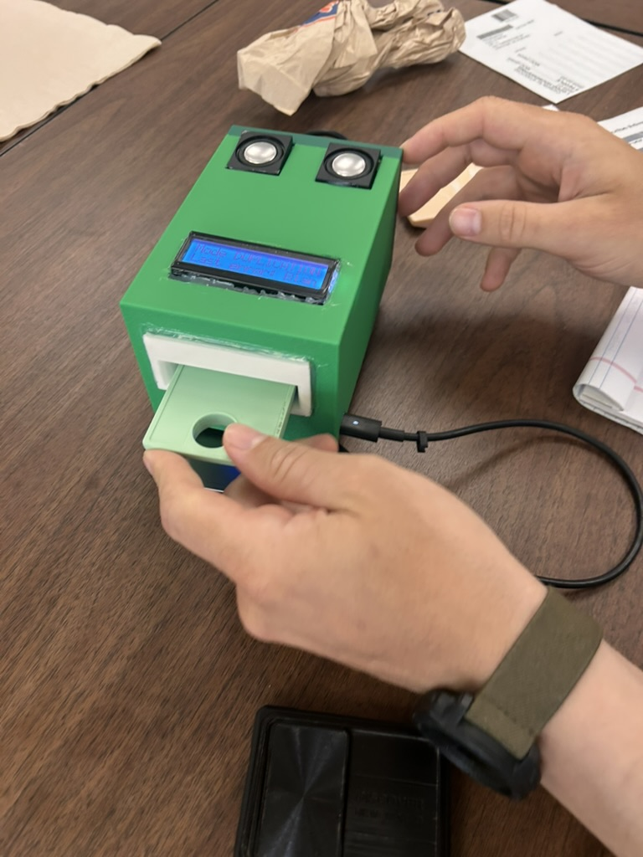
Scribe Micro
Early Prototype – all material, functions subject to change
Fully portable, all-in-one
Onboard speakers
Integrated optical scanner
Text display
Single cartridge slot with LED indicator

Slide 23
Questions???

